Slide 1
HTML Forms

Slide 2
Built-In Server Objects
Review HTML Forms
Building HTML Forms
Reading Form Data with JSP

Slide 3
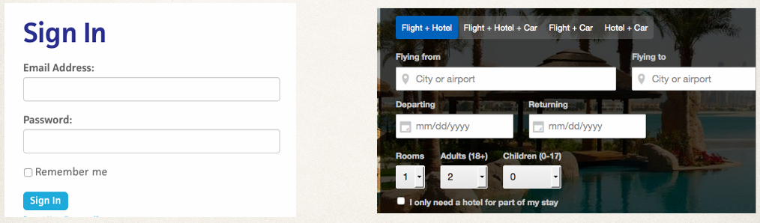
Review HTML Forms
HTML Forms are used to get input from the use

Slide 4
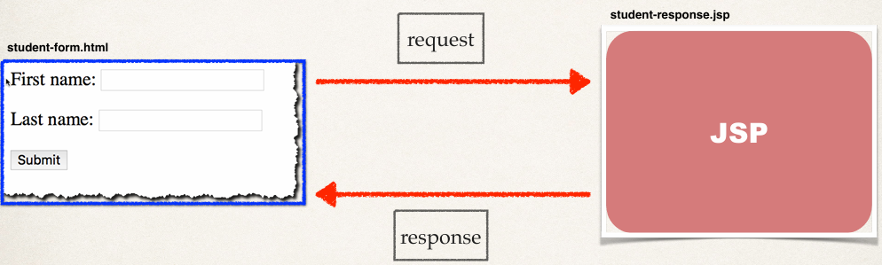
HTTP Request / Response

Slide 5
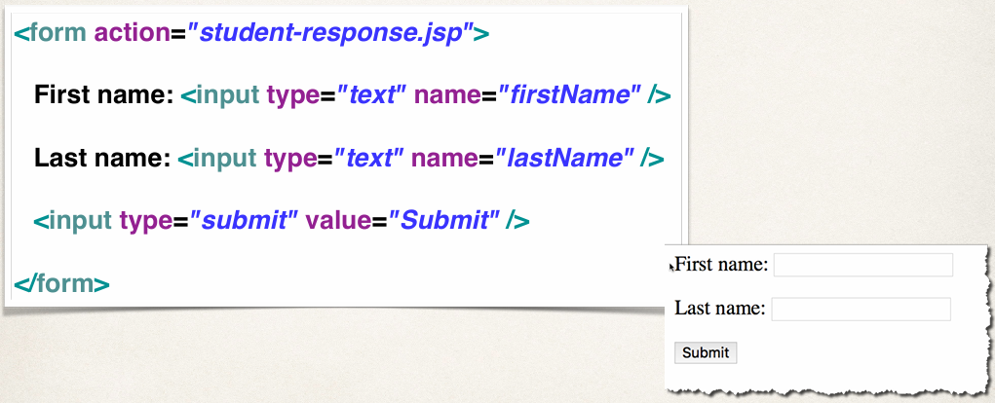
Step 1: Building HTML Form

Slide 6
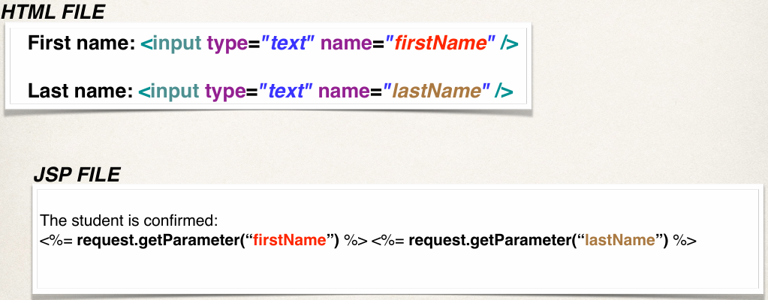
Step 2: Reading Form Data with JSP

Slide 7
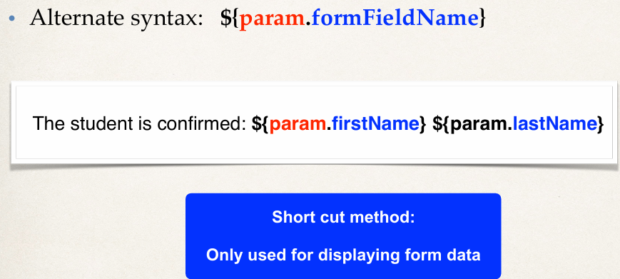
Step 2: Reading Form Data with JSP

Slide 8
Topics
Drop-Down Lists in Action
Drop-Down Lists - HTML
Full JSP Example

Slide 9
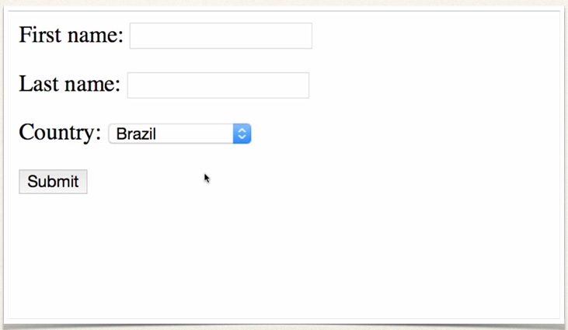
Drop-Down Lists in Action

Slide 10
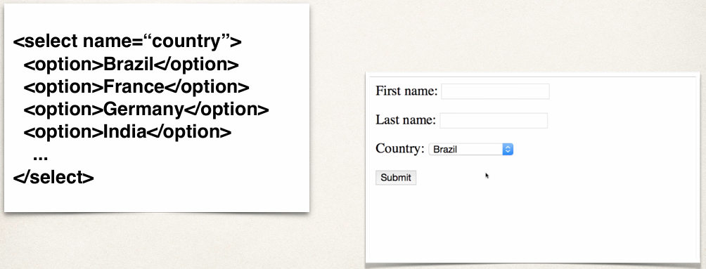
Drop-Down List - HTML <select> Tag

Slide 11
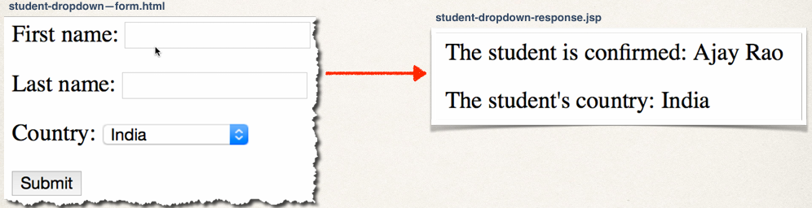
Pulling It All Together

Slide 12
To Do List
Create HTML Form
Create JSP confirmation page

Slide 13
Topics
Radio Button Demo
HTML for Radio Button
Full JSP Example

Slide 14
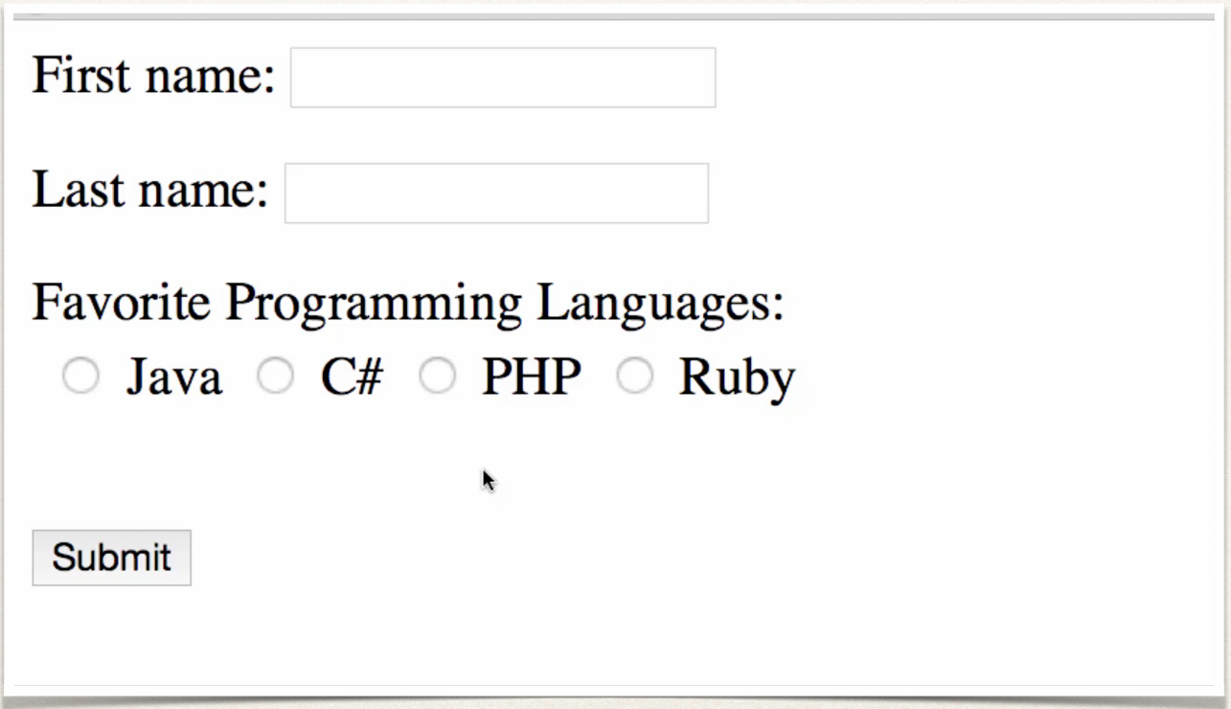
Radio Button Demo

Slide 15
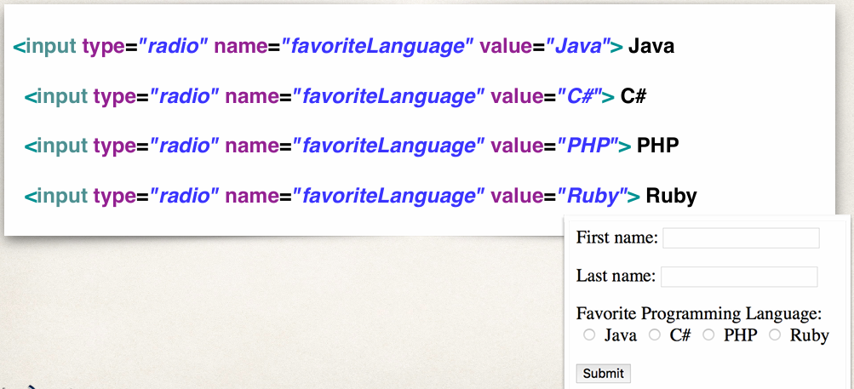
HTML for Radio Buttons

Slide 16
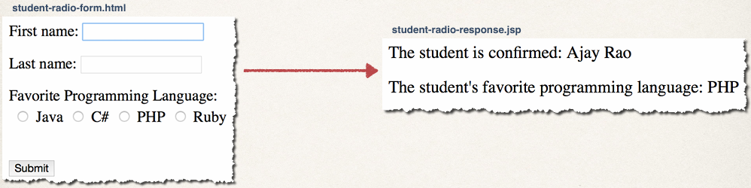
Pulling It All Together

Slide 17
To Do List
Create HTML For
Create JSP confirmation page

Slide 18
Topics
Check Box Demo
HTML for Check Box
Full JSP Example

Slide 19
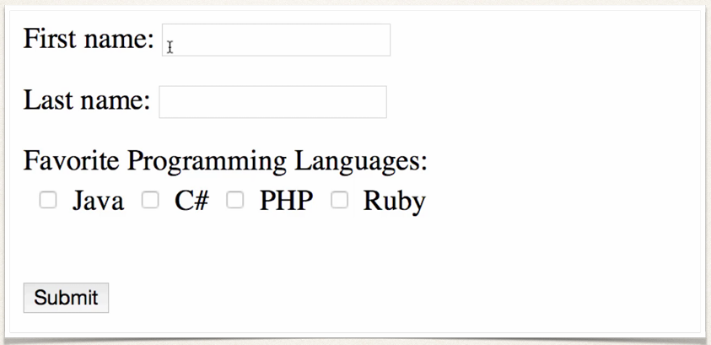
Check Box Demo

Slide 20
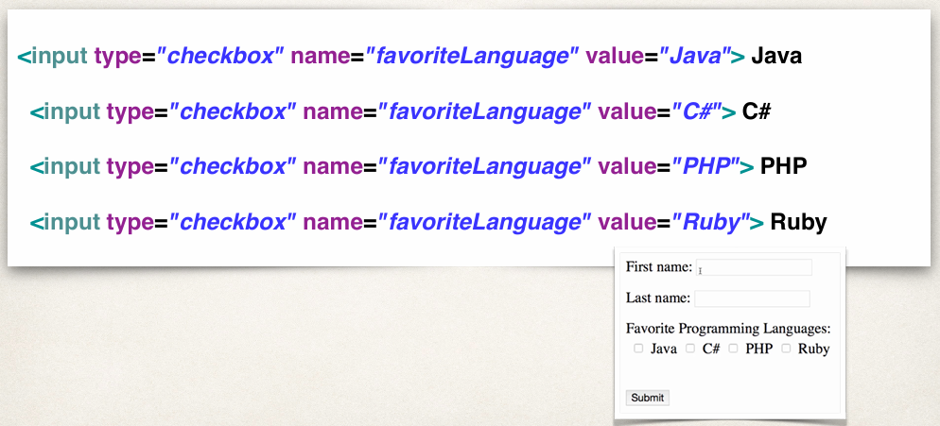
HTML for Check Box

Slide 21
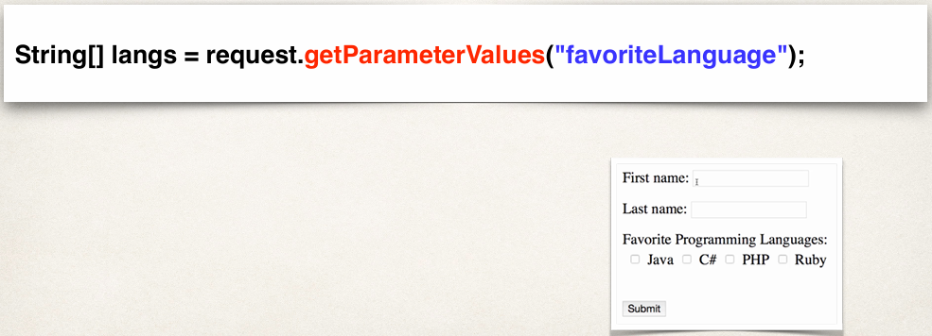
Reading Checkbox Values
The user can check multiple boxes

Slide 22
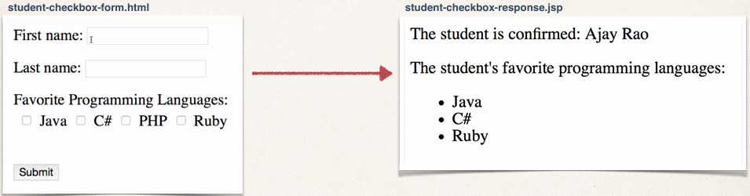
Pulling It All Together

Slide 23
To Do List
Create HTML Form
Create JSP confirmation page

